Slide 1



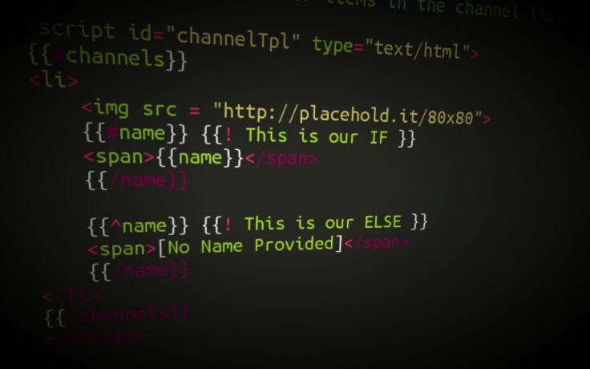

Templating, Routing
Extending functionality
using Collections
JS Apps
SoftUni Team
Technical Trainers
Software University
http://softuni.bg

Slide 2

Table of Contents
What is Sammy.js?
Create custom URLs
Using HTML templates with Mustache.js
Extend JavaScript functionality using lodash.js
What extensions does it offer?
Collection extensions
Array extensions
Function extensions
Object extensions

Slide 3
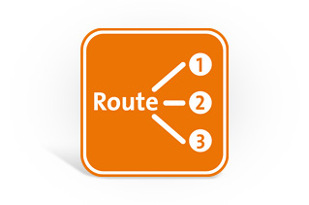
Application routing
Defining URL structure of app

Slide 4

What is Sammy.js?
JavaScript framework providing:
Routes – defining the basic structure of RESTful your application
Events – creating custom events implementing some logic
Well suited for building simple RESTful applications
Using JSON data stores

Slide 5

Installing sammy.js
Download sammy.js from http://sammyjs.org/download
Include it in your project
Place sammy.js after jQuery
Create routes for your application

Slide 6

Application routing
Live Demo

Slide 7

HTML Templating
Fill HTML templates with data

Slide 8

What is Mustache.js?
Logic-less templates:
Used for HTML, config files, source code – anything
Logic-less – does not contain if-else statements or loops.
Entirely defined by tags.
Runs on many languages like: Ruby, Python, JavaScript, PHP, Perl etc.

Slide 9
Installing mustache.js
Download mustache.js from https://github.com/janl/mustache.js
Include it in your project
Place mustache.js after jQuery
Create templates for your application

Slide 10
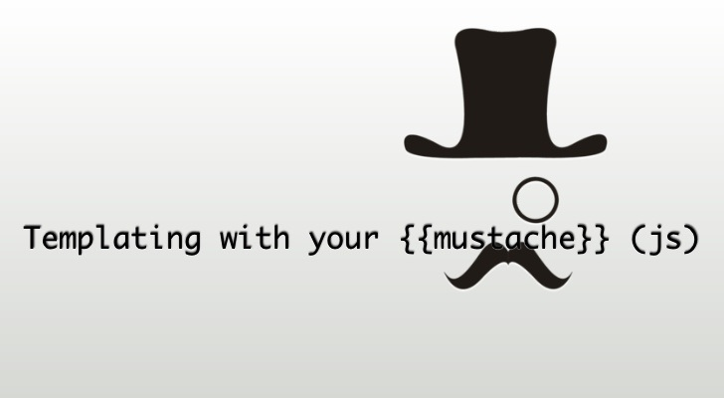
HTML Templating
Live Demo

Slide 11








Templating and Routing
https://softuni.bg/courses/javascript-applications/

Slide 12
License
This course (slides, examples, demos, videos, homework, etc.) is licensed under the "Creative Commons Attribution-NonCommercial-ShareAlike 4.0 International" license
Attribution: this work may contain portions from
"JavaScript Applications" course by Telerik Academy under CC-BY-NC-SA license

Slide 13





Free Trainings @ Software University
Software University Foundation – softuni.org
Software University – High-Quality Education, Profession and Job for Software Developers
softuni.bg
Software University @ Facebook
facebook.com/SoftwareUniversity
Software University @ YouTube
youtube.com/SoftwareUniversity
Software University Forums – forum.softuni.bg

